Slide 1



Terminal warehouse inventory management
Priya modi
Khushi sompura
Guided by prof honey gurnani
[M.tech]
1

Slide 2

Technical Specification
Front End : Visual studio 2019
Back End : Microsoft sql server management studio 2017
diagram: united diagram.drawio
Picture editing : adobe photoshop cs6
2

Slide 3
Imc limited Company kandla
India’s Leading Port Terminalling Company
IMC is a Leading Port Terminalling and Infrastructure Company in India and has presence in the following businesses:
Independent Bulk Liquid Tank Storage
Dry Bulk terminals
International Trading
Oil Exploration
Our Client : Jitendra keshwani
3

Slide 4



4
Why we are creating
this Software?
Currently IMC limited is using SAP software ..
SAP's most features are useful for Purachase Related Task..
But it is not very useful for Terminal Warehouse store's Each and Every items According to Departments And Terminal..
As our Client require to Manintain Storing Each items According to Departments And Terminal manually That's Why We creating This Software

Slide 5





Proposed System
5
Benefits:
Store Facality
Security
Inward
Outward
Reports
Stores Departments Terminal wise
Stores Items Department wise
Only Admin can Access All things
Other users can access only Their tasks
Maintain Inward
Maintain Suppliers Who Suppies Products
Maintain Outward
Material Issue Department Wise
Maintain date wise report
Item wise And Depatment wise report

Slide 6
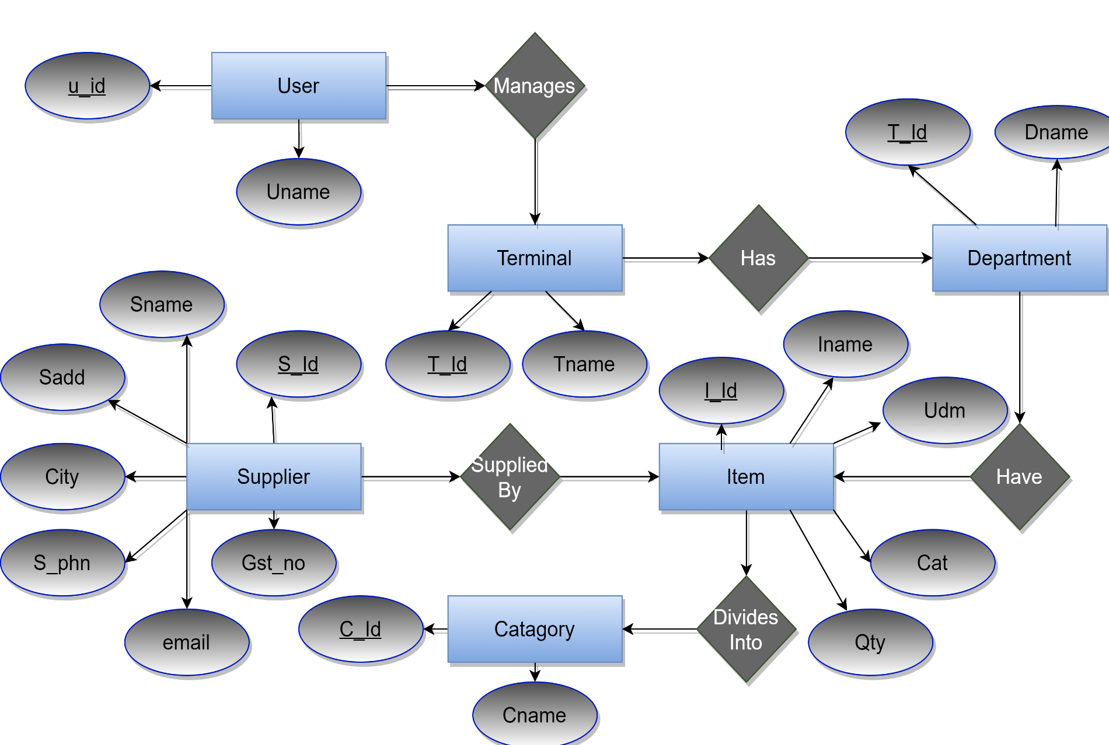
E-R Diagram
6

Slide 7
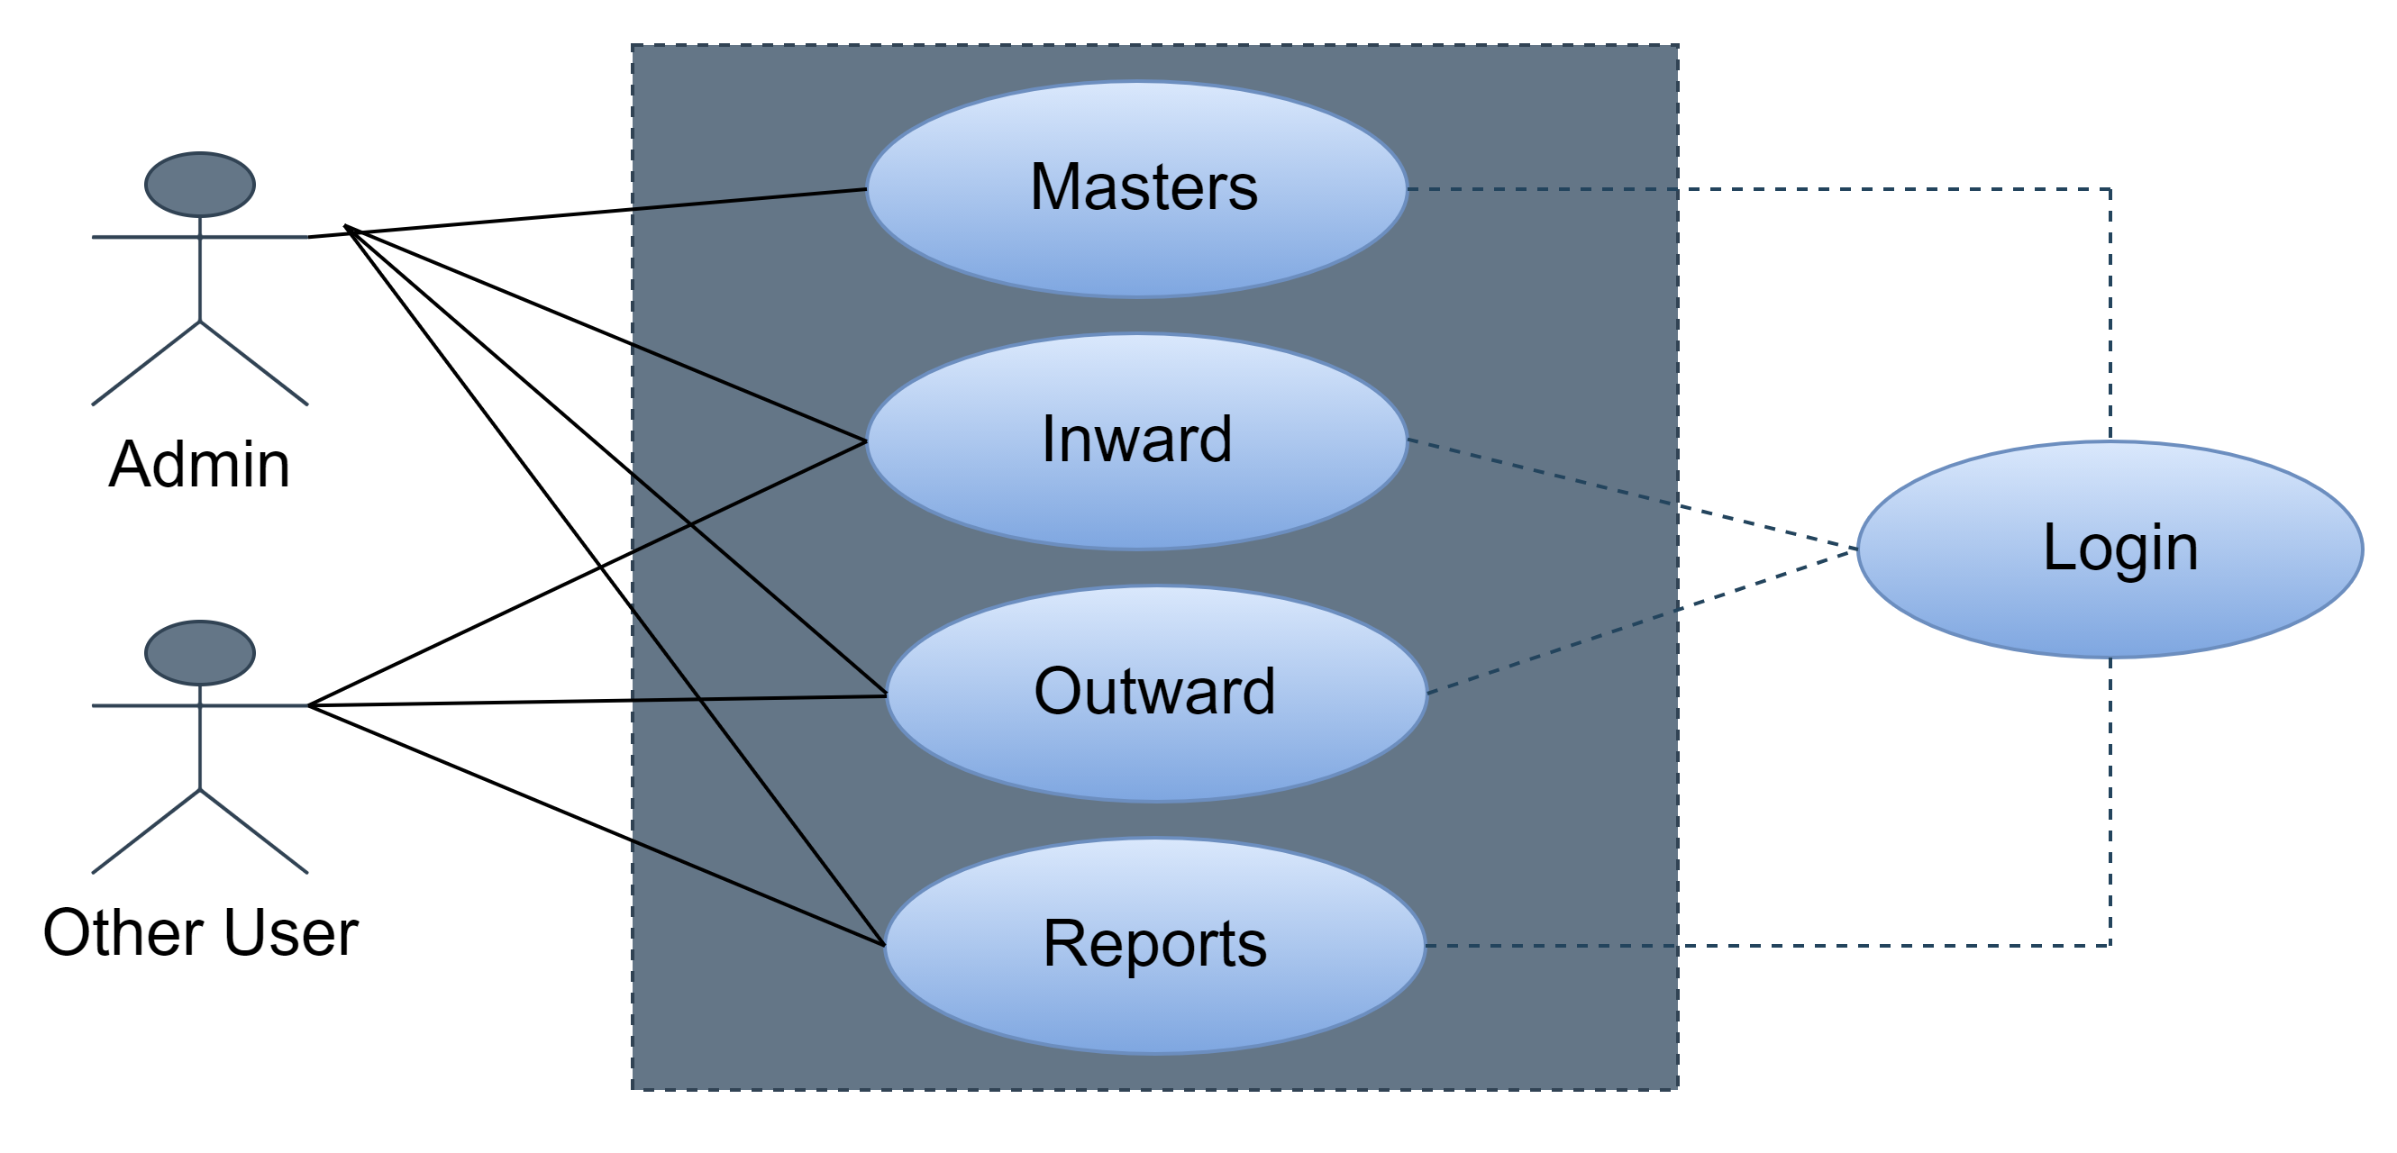
7
Use Case Diagram

Slide 8
Data Dictionary & Demo
8
Excel sheet link
Project Demo link

Slide 9

Thank You
9

